Slide 1
Chapter 16: Nonlinear and Non-Smooth Optimization
Business Analytics: Methods, Models,
and Decisions, 1st edition
James R. Evans

Slide 2
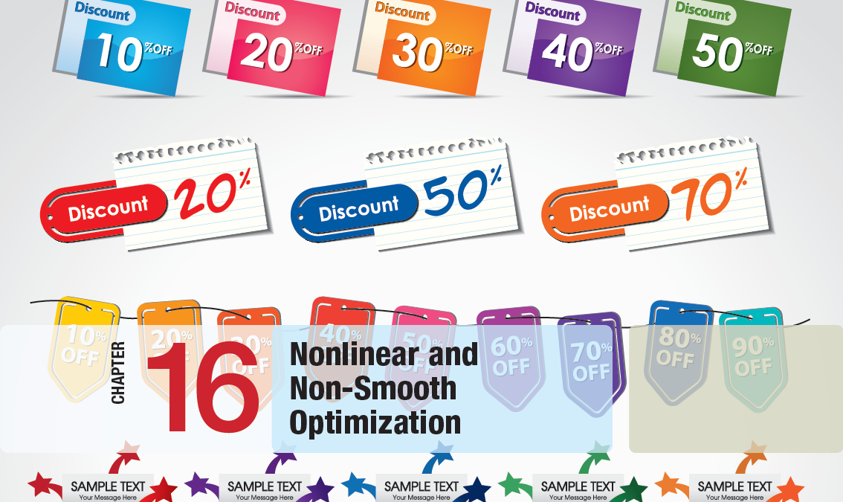

Slide 3
Chapter 16 Topics
Modeling and Solving Nonlinear Optimization Problems
Quadratic Optimization
Evolutionary Solver for Non-Smooth Optimization

Slide 4
Modeling and Solving Nonlinear Optimization Problems
Nonlinear models do not have a common structure like linear and integers models.
They may use many types of mathematical equations and a variety of functional relationships.
Nonlinear models are often difficult to solve.
Solver’s solution engine is LSGRG Nonlinear (Large-Scale Generalized Reduced Gradient)

Slide 5
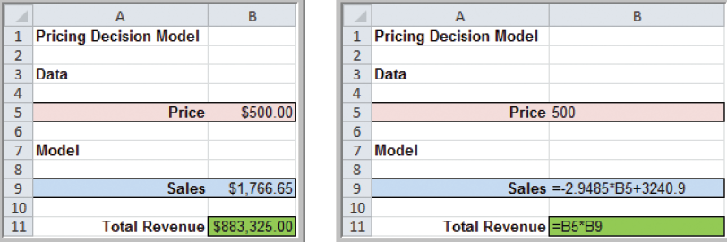
Modeling and Solving Nonlinear Optimization Problems
Example 16.1 Solving the Pricing Decision Model
Recall the Pricing Decision Model (Example 2.9)
Sales = -2.9485(price) + 3,240.9
Total Revenue = (price)(sales)
= -2.9485(price)² + 3240.9(price)
→ a nonlinear function of price
Figure 2.14

Slide 6
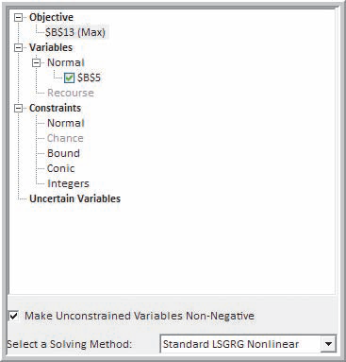
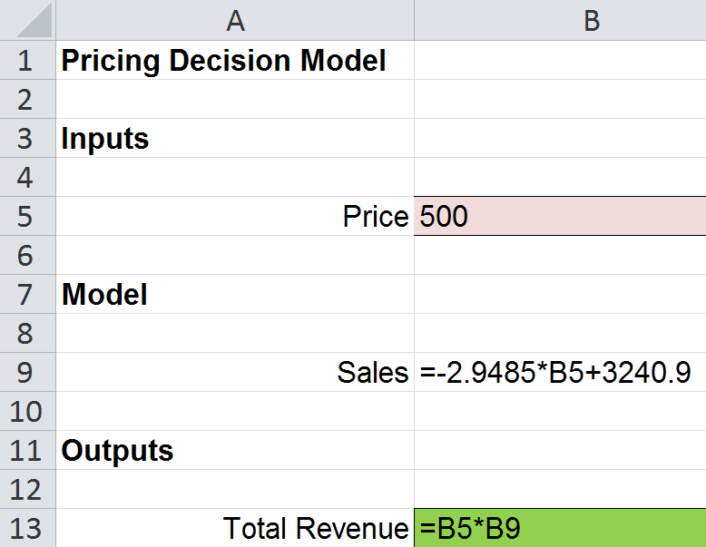
Modeling and Solving Nonlinear Optimization Problems
Example 16.1 (continued) Solving the Pricing Decision Model
From Figure 16.1
Figure 16.2

Slide 7
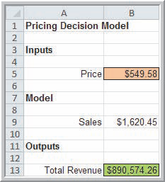
Modeling and Solving Nonlinear Optimization Problems
Example 16.1 (continued) Solving the Pricing Decision Model
Optimal price = $549.58
Maximum total revenue = $890,574
Figure 16.1

Slide 8
Modeling and Solving Nonlinear Optimization Problems
Example 16.2 A Hotel Pricing Model
The Marquis Hotel is considering a major remodeling effort and needs to determine the best combination of rates and room sizes to maximize revenues while keeping the number of rooms at or below the current 450.
Room price ranges:
$70-$90 for standard
$90-$120 for gold
$120-$149 for platinum

Slide 9
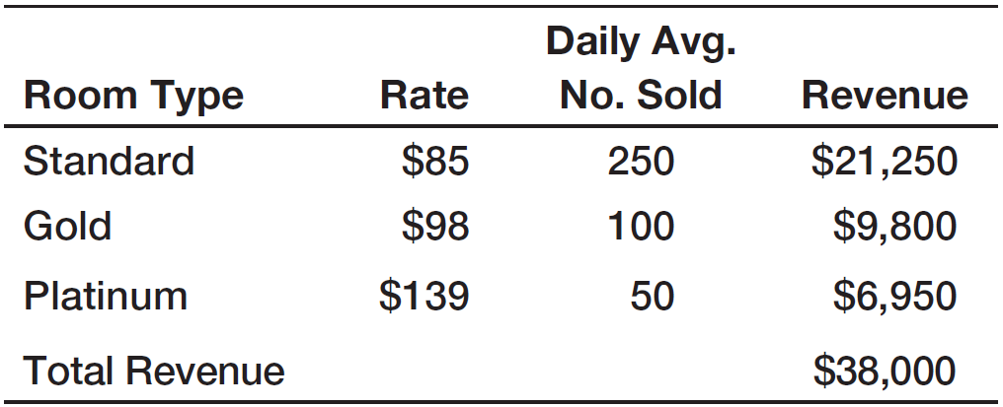
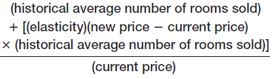
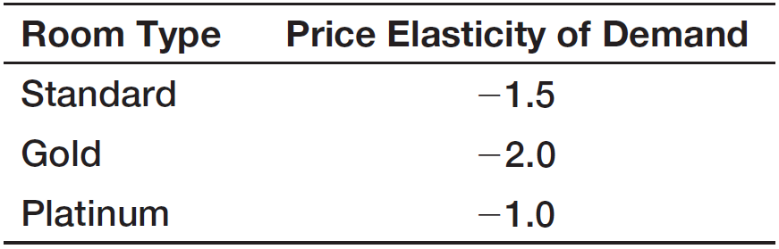
Modeling and Solving Nonlinear Optimization Problems
Example 16.2 (continued) A Hotel Pricing Model
Projected number of rooms
sold for a given room type =
For example, using a standard room:
[250 – 1.5(S – 85)(250)]/85
= 625 – 4.41176(S)
where S = new Standard room price

Slide 10
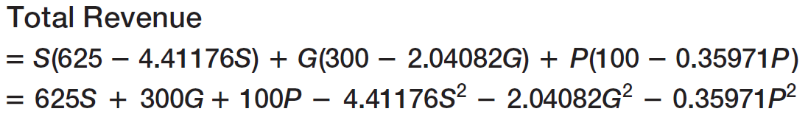
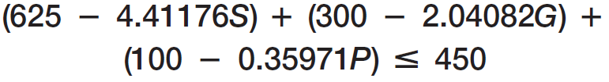
Modeling and Solving Nonlinear Optimization Problems
Example 16.2 (continued) A Hotel Pricing Model

Slide 11
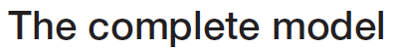
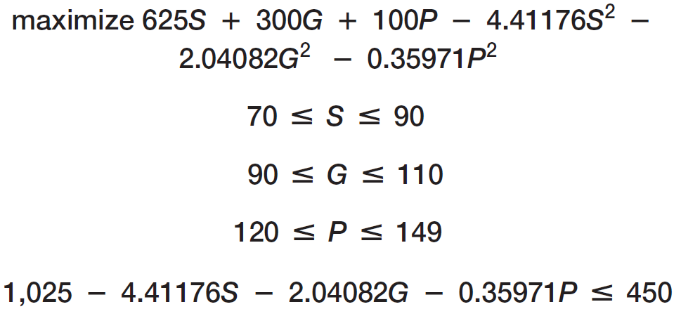
Modeling and Solving Nonlinear Optimization Problems
Example 16.2 (continued) A Hotel Pricing Model

Slide 12
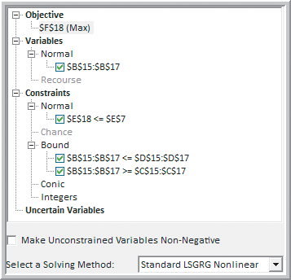
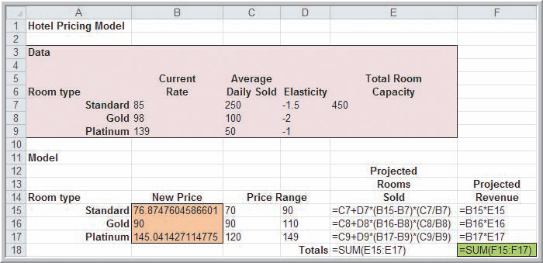
Modeling and Solving Nonlinear Optimization Problems
Example 16.2 (continued) A Hotel Pricing Model
Figure 16.3b
Figure 16.4

Slide 13
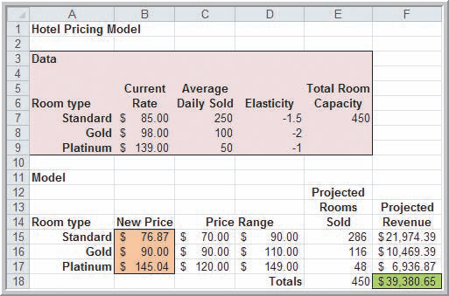
Modeling and Solving Nonlinear Optimization Problems
Example 16.2 (continued) A Hotel Pricing Model
Optimal Solution:
(number rooms @ price)
286 Standard @ $76.87 116 Gold @ $90
48 Platinum @ $145.04
Figure 16.3a

Slide 14
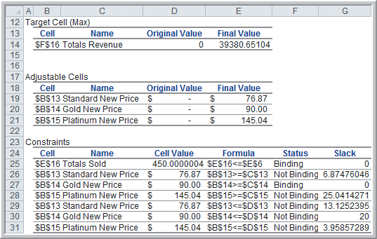
Modeling and Solving Nonlinear Optimization Problems
Example 16.3 Interpreting Solver Reports for the Hotel Pricing Model
Solver Answer Report
If we increase the number of rooms or lower the minimum price for a gold room, then revenue would increase.
Figure 16.5

Slide 15
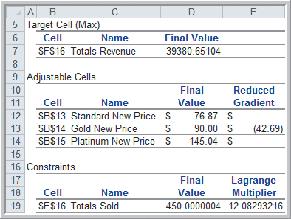
Modeling and Solving Nonlinear Optimization Problems
Example 16.3 (continued) Interpreting Solver Reports for the Hotel Pricing Model
Solver Sensitivity Report
Lagrange multipliers are similar to shadow prices but are only approximations.
If the number of rooms increased by 1, the approximate revenue increase would be $12.08
(the actual increase found by re-solving is $11.87).
Figure 16.6

Slide 16
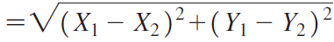
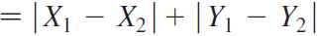
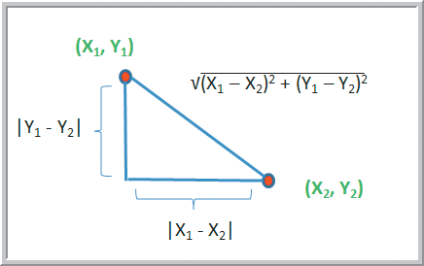
Modeling and Solving Nonlinear Optimization Problems
Locating Central Facilities by Minimizing Distances
Straight line (Euclidean) distance is the hypotenuse of this triangle.
Rectilinear distance is the sum of the left and bottom sides of this triangle.
Figure 16.7

Slide 17
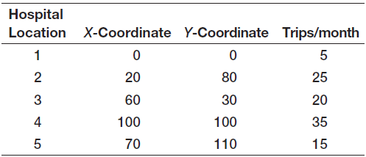
Modeling and Solving Nonlinear Optimization Problems
Example 16.4 Finding the Best Location for a Medical Laboratory
A medical testing laboratory collects blood samples from 5 local hospitals.
Managers want to determine the best location for a new testing facility, taking into consideration both distance and number of trips per month.

Slide 18
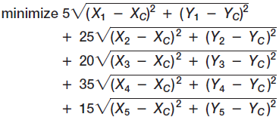
Modeling and Solving Nonlinear Optimization Problems
Example 16.4 (continued) Finding the Best Location for a Medical Laboratory
Distance between each hospital and the new facility is assumed to be straight line
Define X_{i} as the X coordinate of hospital i
X_{c} as the X coordinate of the new facility
Similarly define Y_{i} and Y_{c}

Slide 19
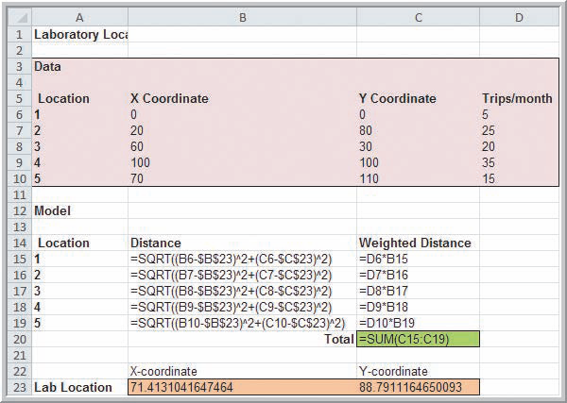
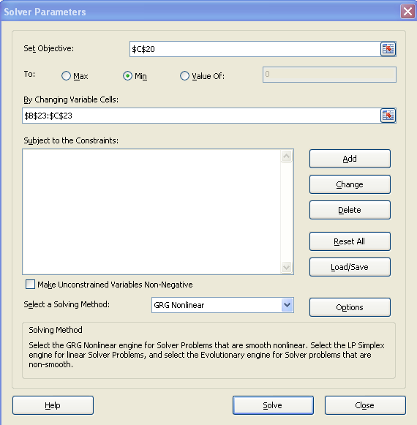
Modeling and Solving Nonlinear Optimization Problems
Example 16.4 (continued) Finding the Best Location for a Medical Laboratory
Figure 16.8b

Slide 20
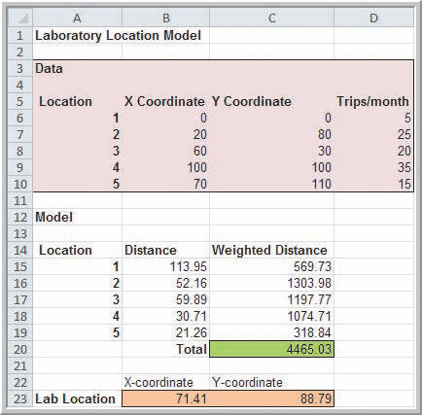
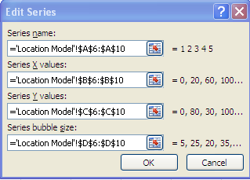
Modeling and Solving Nonlinear Optimization Problems
Example 16.4 (continued) Finding the Best Location for a Medical Laboratory
Optimal Laboratory Location:
(X, Y) = (71.41, 88.79)
To create a bubble chart of the locations, specify the series:
Figure 16.8a

Slide 21
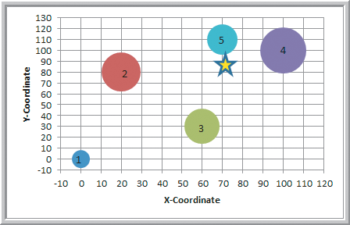
Modeling and Solving Nonlinear Optimization Problems
Example 16.4 (continued) Finding the Best Location for a Medical Laboratory
indicates the optimal laboratory location.
Hospital bubble sizes correspond to trips/month.
Figure 16.9

Slide 22

Modeling and Solving Nonlinear Optimization Problems
Analytics in Practice:
Locating Collection Facilities for the Red Cross
The Red Cross uses location models for analyzing possible site locations.
Distance traveled is the main criteria but, by adding weights to the model, they also consider cost per square foot, highway access, site availability, and location of processing facilities.
Over time, the chosen optimal locations have saved on expenditures for fuel and transportation.

Slide 23
Modeling and Solving Nonlinear Optimization Problems
Economic Order Quantity (EOQ) Model
The EOQ model is used to model inventories of retail goods such as groceries and commodities that have stable demand over time.
The EOQ is the order amount that minimizes inventory costs:
- Purchase costs
- Order preparation costs
- Inventory holding costs

Slide 24
Modeling and Solving Nonlinear Optimization Problems
Assumptions of the EOQ Model
Single inventory item
Entire order arrives at one time
Demand is constant over time
No shortages
Define:
Q = order quantity
D = annual demand
C = item cost per unit
C_{o} = cost per order placed
i = inventory carrying charge per unit

Slide 25
Modeling and Solving Nonlinear Optimization Problems
EOQ Model (continued)
Annual ordering cost
(number orders/year)(cost per order)
(D/Q)C_{o}
Annual holding cost
(annual holding cost/unit)(average inventory)
(iC)(Q/2)
Total annual inventory cost
annual ordering cost + annual holding costs
DC_{o}/Q + iCQ/2
→ This is a nonlinear function of Q

Slide 26
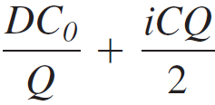
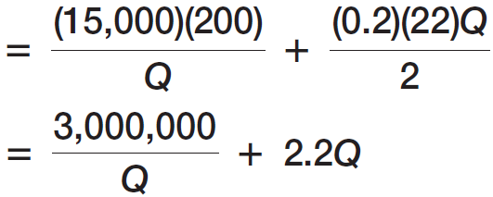
Modeling and Solving Nonlinear Optimization Problems
Example 16.5 Solving the EOQ Model
Annual demand for a product is 15,000 units.
Ordering costs are $200 per order.
Purchase cost is $22 per item.
Carrying charge rate is 20%.
Total annual inventory cost:

Slide 27
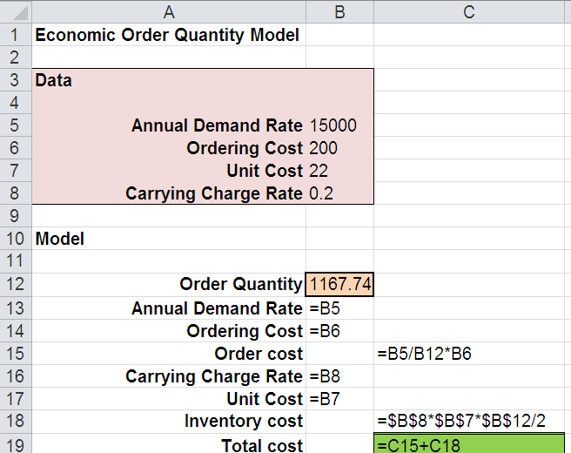
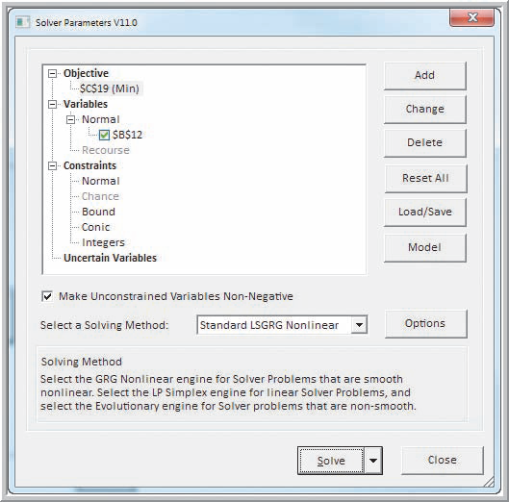
Modeling and Solving Nonlinear Optimization Problems
Example 16.5 (continued) Solving the EOQ Model
From Figure 16.10b
Figure 16.11

Slide 28
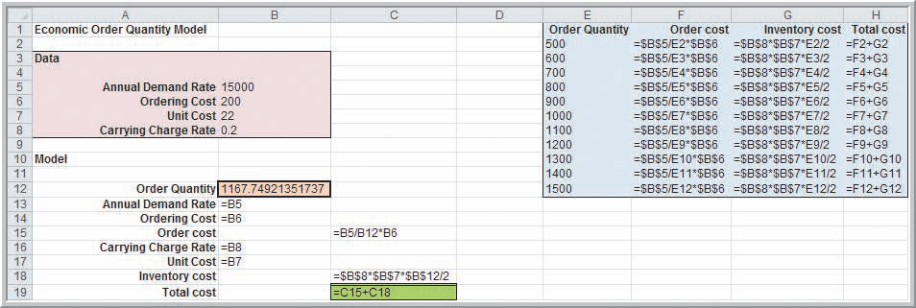
Modeling and Solving Nonlinear Optimization Problems
Example 16.5 (continued) Solving the EOQ Model
Cost computations for order quantities from 500 to 1500.
Figure 16.10b

Slide 29
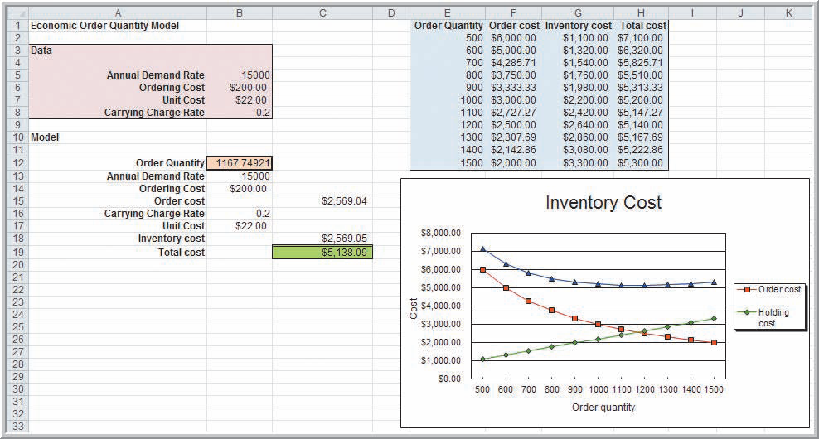
Modeling and Solving Nonlinear Optimization Problems
Example 16.5 (continued) Solving the EOQ Model
EOQ = 1167.75 units (minimizes total cost).
Figure 16.10a

Slide 30
Modeling and Solving Nonlinear Optimization Problems
EOQ Model
The EOQ model does not specify when to order the optimal quantity.
The reorder point is the inventory level when a new order is placed.
Lead time is how long it takes to receive an item once the order is placed.
Demand during lead time is the amount of product sold after an order is placed but before it is received.

Slide 31
Modeling and Solving Nonlinear Optimization Problems
Reorder point for the EOQ model
For the EOQ model, the reorder point is simply demand during lead time.
In the previous example, suppose lead time is t = 1 week (1/52 years).
Recall demand: D =15,000/year
EOQ reorder point = Demand during lead time
= Dt
= (15,000 units/year)(1/52 years)
= 288 units

Slide 32
Modeling and Solving Nonlinear Optimization Problems
Solver does not guarantee finding the absolute best solution to nonlinear problems.
Global optimal solution is the absolutely best one (e.g.; the highest mountain peak - Mt. Everest)
Local optimal solution is the best one locally (e.g.; the highest peak in the USA - Mt. McKinley)
The message, “Solver has found a solution” indicates a local optimal.
To try and find the global optimum in Solver, re-run the model using different starting points.

Slide 33
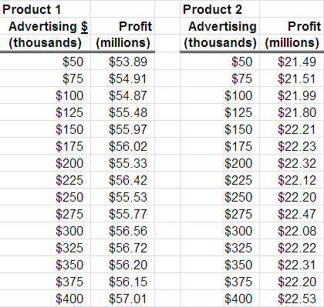
Modeling and Solving Nonlinear Optimization Problems
Example 16.6 A Model for Advertising Strategy
DTP Corporation produces two major products
The total budget for advertising is $500,000.
Experimental data has been collected on profits resulting from various advertising expenditures.
How should DTP allocate the $500,000 between the two products assuming that at least $50,000 must be spent on each product?
From Figure 16.12

Slide 34
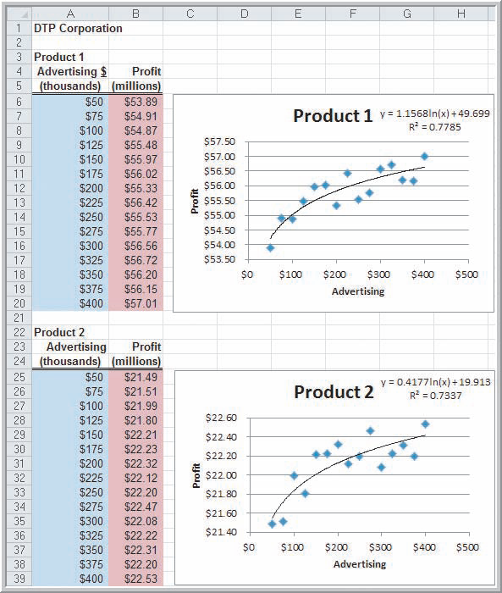
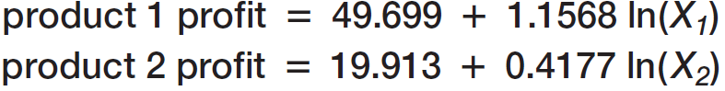
Modeling and Solving Nonlinear Optimization Problems
Example 16.6 (continued) A Model for Advertising Strategy
Using Trendlines, logarithmic functions are found to fit the advertising and profit data.
X_{i} is the amount to spend on advertising product i.
Figure 16.12

Slide 35
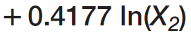
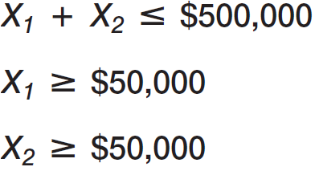
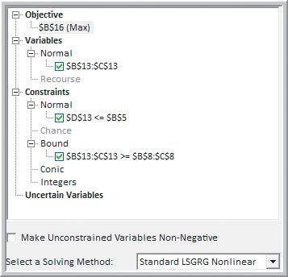
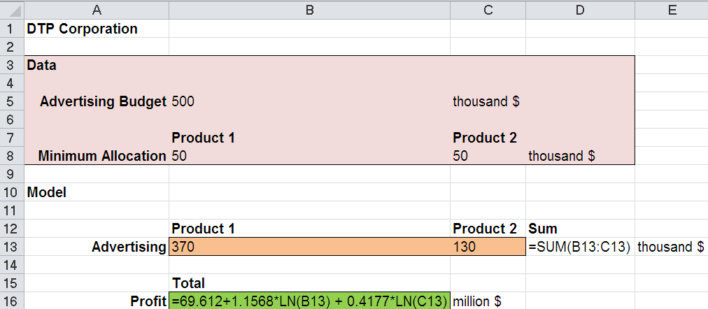
Modeling and Solving Nonlinear Optimization Problems
Example 16.6 (continued) A Model for Advertising Strategy
From Figure 16.13
Figure 16.14

Slide 36
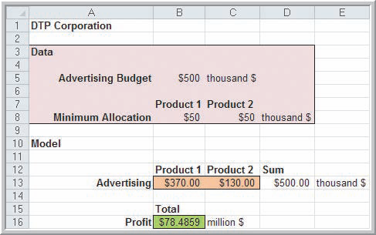
Modeling and Solving Nonlinear Optimization Problems
Example 16.6 (continued)
A Model for Advertising Strategy
Optimal profit = $78.49
Spend on advertising:
$370 on product 1
$130 on product 2
Figure 16.13

Slide 37
Quadratic Optimization
Markowitz Portfolio Model
A classic quadratic optimization model in finance
Seeks to minimize risk of an investment portfolio
Risk is measured using variances and covariances of the individual investments.
A minimum specified return constrains the model.
The decision variables are the percentage of the portfolio allocated to the various investments, for example, 60% equities, 30% bonds, 10% cash.

Slide 38
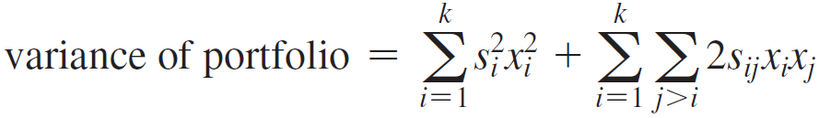
Quadratic Optimization
Markowitz Portfolio Model
The risk of a portfolio is weighted sum of the variances and covariances
x_{i} = fraction of the portfolio invested in stock i
s_{i}² = sample variance in the return of stock i
s_{ij} = sample covariance between stocks i and j

Slide 39
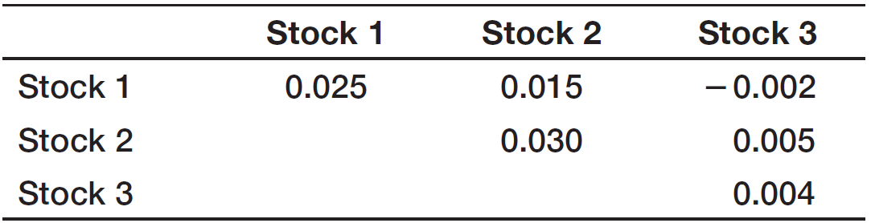
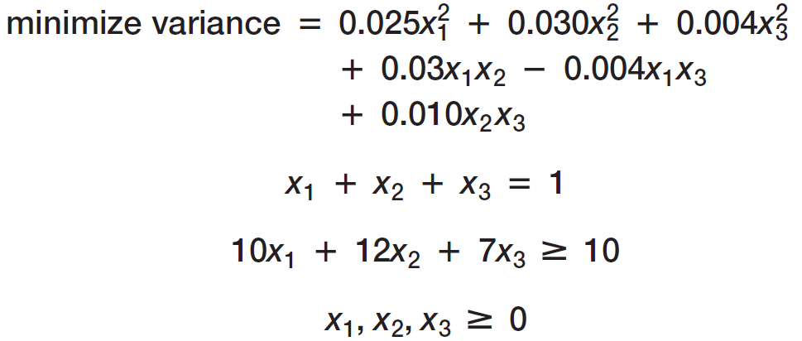
Quadratic Optimization
Example 16.7 An Example of the Markowitz Model
An investor is considering 3 stock investments.
Variance-covariance matrix
Expected Returns
10%
12%
7%
x_{i} = fraction of the portfolio invested in stock i

Slide 40
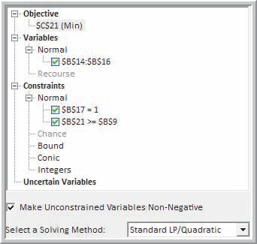
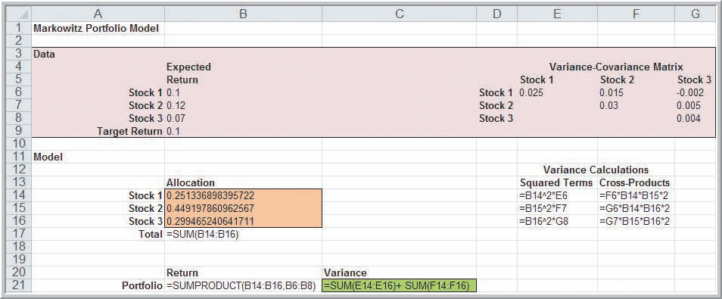
Quadratic Optimization
Example 16.7 (continued)
An Example of the Markowitz Model
Figure 16.16
Figure 16.15b

Slide 41
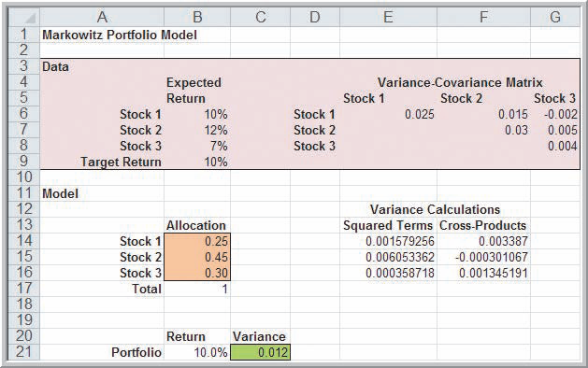
Quadratic Optimization
Example 16.7 (continued) An Example of the Markowitz Model
Optimal risk = 1.2%
Allocations:
25% stock 1
45% stock 2
30% stock 3
Figure 16.15a

Slide 42
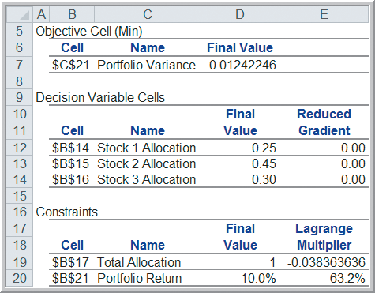
Quadratic Optimization
Example 16.7 (continued) An Example of the Markowitz Model
Sensitivity Report
Risk will increase ~63.2% if portfolio return increased 1% (to 11%).
Re-solving the problem using 11% return gives the exact risk increase of 67%
(from 1.2% to 2.0%).
Figure 16.17

Slide 43
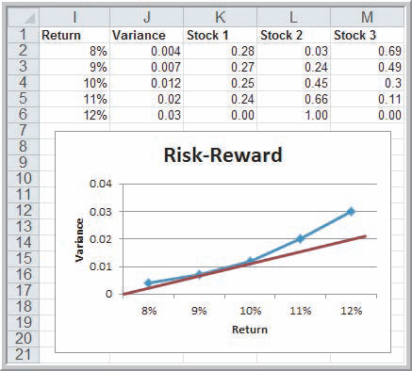
Quadratic Optimization
Example 16.8 Analyzing Risk Versus Reward
(Markowitz Portfolio Model)
Risk Solver’s Parametric Analysis
Tangent line through origin indicates optimal risk-reward:
risk ≅ 1%
return ≅ 9.5%
An alternative approach is to solve a nonlinear model with a maximum return of 1% risk.
The resulting optimal solution is 9.6% return.
Figure 16.18

Slide 44

Quadratic Optimization
Analytics in Practice: Applying Nonlinear Optimization at Prudential Securities
Prudential Securities has a mortgage-backed securities department for managing complex investments.
Nonlinear optimization models are used to match clients’ investment performance profiles with constraints under various interest rate scenarios.
Weighting schemes reflect managers’ views of the direction of future interest rates.

Slide 45
Evolutionary Solver for Non-Smooth Optimization
Evolutionary Solver for Non-Smooth Optimization
Excel functions IF, ABS, MAX, MIN lead to non-smooth models (have abrupt changes).
Solver’s Standard Evolutionary algorithm can be used to solve non-smooth models.
Solver uses a heuristic solution approach.
Heuristics use intelligent rules to search among solutions and locate the best one.

Slide 46
Evolutionary Solver for Non-Smooth Optimization
Example 16.9 Using Evolutionary Solver for the K&L Design Fixed-cost Problem (Example 15.11)
K&L makes hand-painted jewelry boxes.
Forecasted sales are 150 in autumn, 400 in winter, and 50 in spring.
Unpainted boxes cost $20.
Boxes take 2 hours to complete.
Holding cost per item = 6%(20) = $1.20/quarter
Hourly labor rates are $5.50, $7.00, and $6.25 during autumn, winter, and spring, respectively.
Rental equipment costs $65 per season of production.

Slide 47
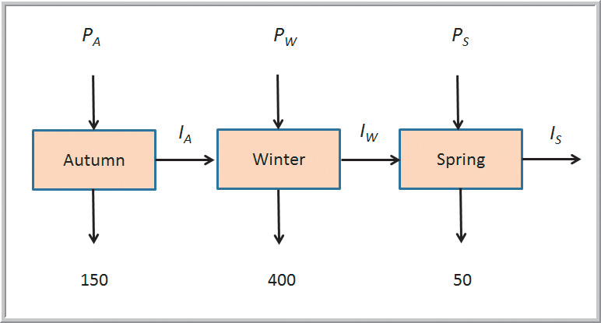
Evolutionary Solver for Non-Smooth Optimization
Example 16.9 (continued) Using Evolutionary Solver for the K&L Design Fixed-cost Problem
If P_{i} > 0, there is a fixed cost of $65.
Figure 14.16

Slide 48

Evolutionary Solver for Non-Smooth Optimization
Example 16.9 (continued) Using Evolutionary Solver for the K&L Design Fixed-cost Problem
P_{i} = amount to produce in season i
I_{j} = inventory at the end of season j
Additionally, for Evolutionary Solver, set
upper bounds to restrict the search space:
P_{i} ≤ 600
I_{j} ≤ 600
P_{i} ≥ 0
I_{j} ≥ 0

Slide 49


Evolutionary Solver for Non-Smooth Optimization
Example 16.9 (continued)
Using Evolutionary Solver for the
K&L Design Fixed-cost Problem
From Figure 16.19

Slide 50

Evolutionary Solver for Non-Smooth Optimization
Example 16.9 (continued) Using Evolutionary Solver for the K&L Design Fixed-cost Problem
Evolutionary Solver solution:
600 units in autumn
0 units in winter
0 units in spring
Rent the equipment only in autumn.
P_{A} = 600
I_{A} = 450
I_{W} = 50
Same solution as
in Example 15.11
Figures 16.19 and 16.20

Slide 51

Evolutionary Solver for Non-Smooth Optimization
Example 16.10 A Rectilinear Location Model
Edwards Manufacturing is studying where to locate a tool bin on the factory floor.
X,Y coordinates of the 5 production areas and demand for tools are shown below.
Distances to the tool bin are rectilinear (parallel to the coordinate system).

Slide 52

Evolutionary Solver for Non-Smooth Optimization
Example 16.10 (continued)
A Rectilinear Location Model
A non-smooth optimization model for minimizing weighted rectilinear distances to the tool bin:
X ≥ 0
Y ≥ 0
For Evolutionary Solver, set bounds to restrict the search space.
X ≤ 5
Y ≤ 5

Slide 53


Evolutionary Solver for Non-Smooth Optimization
Example 16.10 (continued)
A Rectilinear Location Model
Figure 16.22
From Figure 16.21

Slide 54

Evolutionary Solver for Non-Smooth Optimization
Example 16.10 (continued)
A Rectilinear Location Model
Evolutionary Solver solution
Weighted Distance = 162
X = 2.5
Y = 2.0
From Figure 16.21

Slide 55
Evolutionary Solver for Non-Smooth Optimization
Optimization Models for Sequencing and Scheduling
Job-sequencing problems involve finding an optimal sequence by which to process jobs.
Lateness (L_{i}) is the difference between completion time (C_{i}) and due date (D_{i}):
L_{i} = C_{i} – D_{i}
Tardiness (T_{i}) is the amount of time by which completion time exceeds due date:
T_{i} = max {0, L_{i}}

Slide 56
Evolutionary Solver for Non-Smooth Optimization
Optimization Models for Sequencing and Scheduling
Shortest processing time (SPT) sequencing of jobs minimizes the average completion time for all jobs.
Earliest due date (EDD) sequencing of jobs minimizes the maximum number of tardy jobs.
Other criteria such as average tardiness, total tardiness, or total lateness are also of interest.
Evolutionary Solver can be used for such problems.

Slide 57
Evolutionary Solver for Non-Smooth Optimization
Example 16.11 Finding Optimal Job Sequences
A custom manufacturing company has 10 jobs waiting to be processed.
Processing times and due dates are shown below.
A sequence of integers for the job ordering is called a permutation.
The objective is to find the permutation that optimizes the chosen criteria.

Slide 58

Evolutionary Solver for Non-Smooth Optimization
Example 16.11 (continued)
Finding Optimal Job Sequences
The INDEX function is used to identify the processing times and due dates for the assigned jobs.
8 different objective criteria choices
From Figure 16.23

Slide 59


Evolutionary Solver for Non-Smooth Optimization
Example 16.11 (continued)
Finding Optimal Job Sequences
Minimizing Total Tardiness
Define the decision variables as a permutation by using the alldifferent constraint type.
Figure 16.24
Figure 16.25

Slide 60

Evolutionary Solver for Non-Smooth Optimization
Example 16.11 (continued)
Finding Optimal Job Sequences
Solution that minimizes
Total Tardiness
Avg.completion time = 38.3
Maximum # tardy = 7
Total tardiness = 108
Figure 16.26

Slide 61

Evolutionary Solver for Non-Smooth Optimization
Example 16.11 (continued)
Finding Optimal Job Sequences
Solution that minimizes Maximum Number Tardy
(coincides with EDD rule)
Avg.completion time = 38.4
Maximum tardy = 4
Total tardiness = 119
From Figure 16.26

Slide 62

Evolutionary Solver for Non-Smooth Optimization
Example 16.11 (continued)
Finding Optimal Job Sequences
Solution that minimizes Average Completion Time
(coincides with SPT rule)
Avg.completion time = 33.8
Maximum tardy = 4
Total tardiness = 126
From Figure 16.26

Slide 63
Evolutionary Solver for Non-Smooth Optimization
The Traveling Salesperson Problem
A salesperson needs to visit n different cities and return home in the minimum total distance.
A tour is a route that visits each city once and returns to the start.
Applications include FedEx, UPS, and soft drink vendors that deliver goods to customers.
With n customers or cities, there are (n−1)! tours.
If n = 14, more than 6 billion tours are possible.

Slide 64

Evolutionary Solver for Non-Smooth Optimization
Example 16.12
Touring American Baseball League Cities
A baseball fan living in Detroit wants to visit 14 ballparks of American League teams.
Distances between all pairs of the 14 cities

Slide 65
Evolutionary Solver for Non-Smooth Optimization
Example 16.12 (continued)
Touring American Baseball League Cities
Number the cities from 0 to 13.
City 0 will be the starting/ending point and any city can be assigned this position.
The 13 decision variables are the city to visit next (from cities 0 to 12).
City 13 is assigned to return to city 0.
Use the alldifferent constraint for 13 decision variables so that each city is visited only once.

Slide 66

Evolutionary Solver for Non-Smooth Optimization
Example 16.12 (continued)
Touring American Baseball League Cities
For each From city, find the To city that minimizes total distance traveled.
The 13 decision variables (To cities) are specified as alldifferent constraints.
Figure 16.29

Slide 67


Evolutionary Solver for Non-Smooth Optimization
Example 16.12 (continued)
Touring American Baseball League Cities
Figure 16.27b

Slide 68

Evolutionary Solver for Non-Smooth Optimization
Example 16.12 (continued)
Touring American Baseball League Cities
Figure 16.29
Figure 16.28

Slide 69
Evolutionary Solver for Non-Smooth Optimization
Example 16.12 (continued)
Touring American Baseball
League Cities
Solution: Travel 6718 miles.
0. Detroit, Michigan
1. Milwaukee, Wisconsin
2. Minneapolis, Minnesota
3. Seattle, Washington
4. Oakland, California
5. Los Angeles, California
6. Dallas, Texas
7. Kansas City, Kansas
8. Chicago, Illinois
9. Cleveland, Ohio
10. Baltimore, Maryland
11. New York City, New York
12. Boston, Massachusetts
13. Toronto, Ontario
14. Detroit, Michigan
Figure 16.29

Slide 70
Chapter 16 - Key Terms
Economic order quantity
Global optimal solution
Lagrange multiplier
Lead time
Local optimal solution
Nonlinear optimization model (nonlinear program)
Permutation
Quadratic optimization model
Rectilinear distance
Reduced gradient
Reorder point
Tour
Traveling salesperson problem (TSP)

Slide 71
Case Study Performance Lawn Equipment (16)
Recall that PLE produces lawnmowers and a medium size diesel power lawn tractor.
The accounting department reviewed the assumptions of the model in case (14).
Rather than use a fixed rate-change cost of $5 per unit, they would like you to implement a non-linear cost function since cost grows faster as the deviation from production in the previous month increases.
Modify your original model and analysis and write a formal report summarizing your results.

Slide 72


